Slide 1
Final Project: Haptic Glove
Matt Ashcraft
Shelbe Timothy
Notes:
1

Slide 2
hap·tic adjective \ˈhap-tik\
1: relating to or based on the sense of touch
2: characterized by a predilection for the sense of touch <a haptic person>
Notes:
2

Slide 3
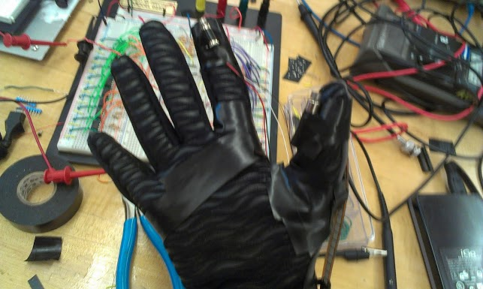
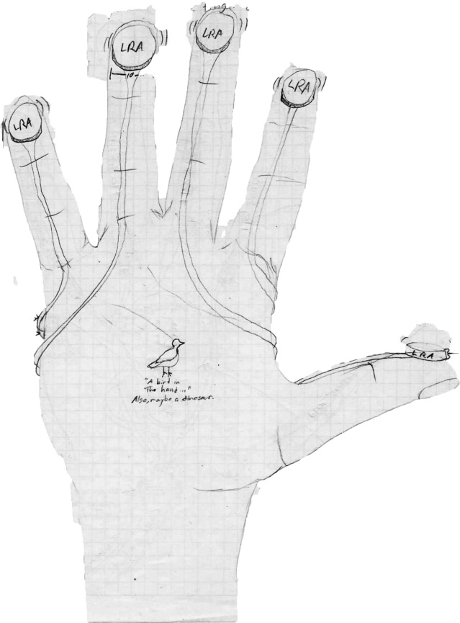
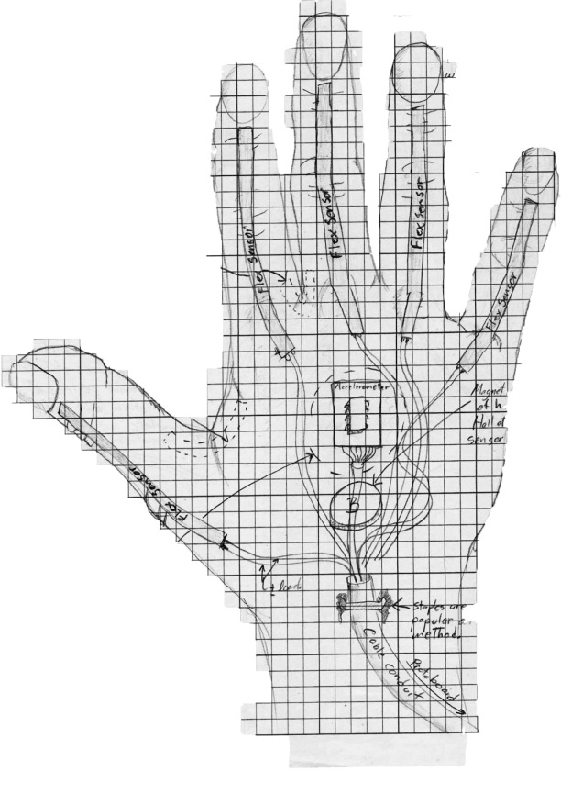
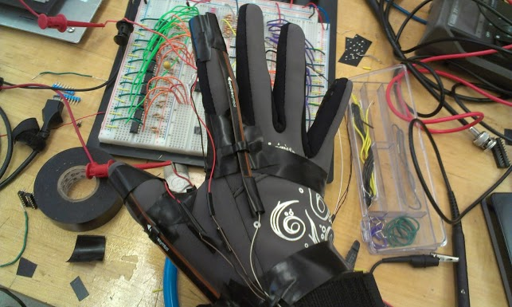
Idea

Slide 4
Sensor Array
Signal Processing
System Overview
Signal Interpretation
Feedback magnitude calculation
Haptic feedback delivery
Notes:
4

Slide 5
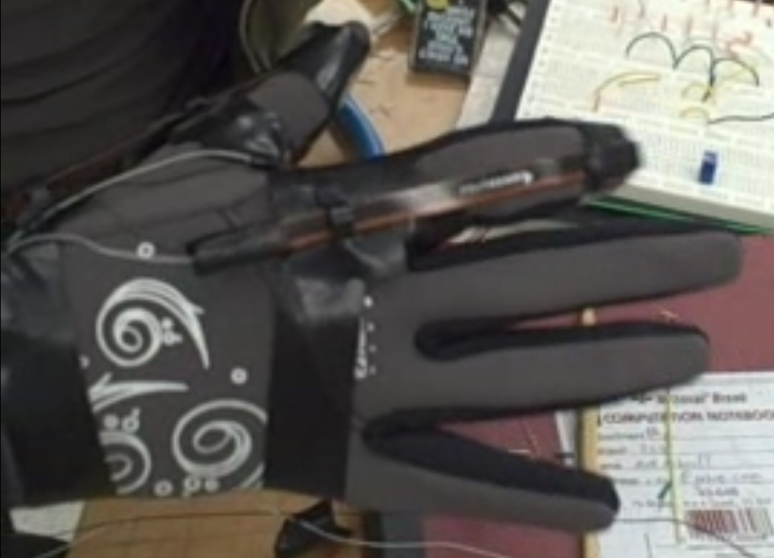
Sensor Array
Sensor Array
Flex sensor array
Human haptic sensor array
The flex strip behaves similar to a trimpot, resistance range ~ 12 – 25 kΩ
The haptic sensors are ERMs
Notes:
5

Slide 6
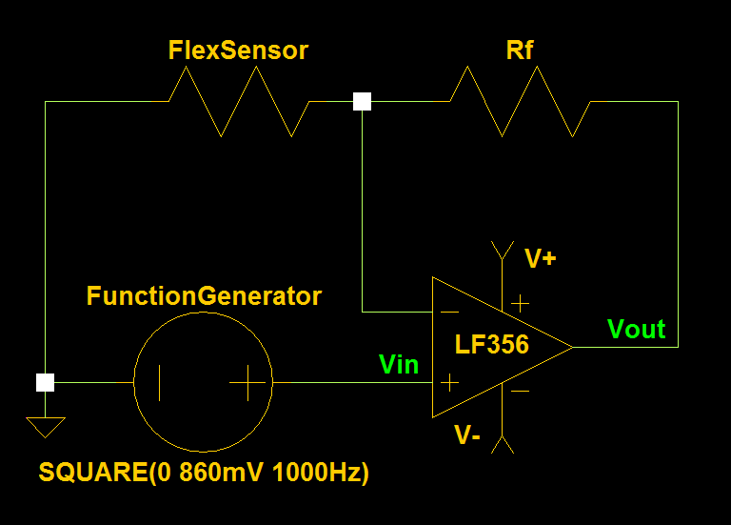
Signal Processing
Flex Sensor Signal Amplification
The variable gain of the non-inverting
op-amp ~ 4 – 8 with a Vin = 860mV
Notes:
6

Slide 7
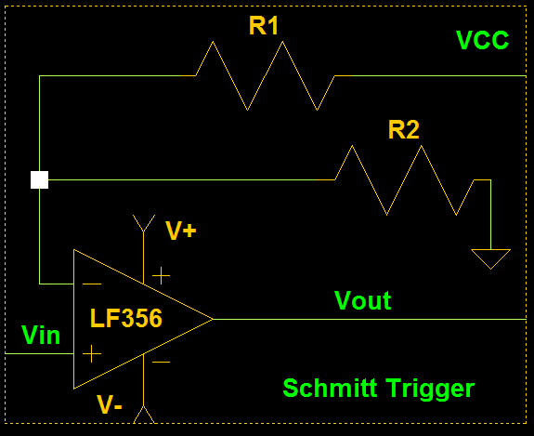
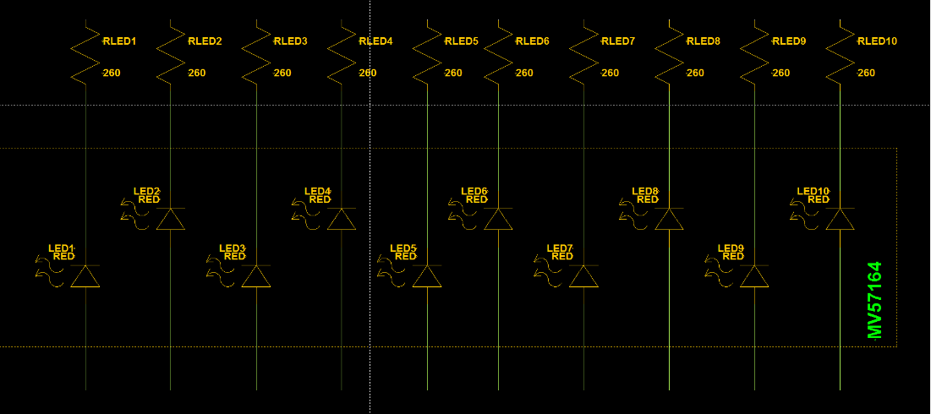
Signal Interpretation
Notes:
7

Slide 8
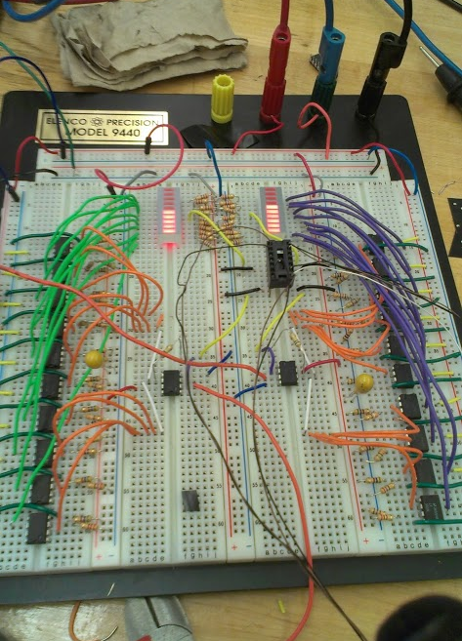
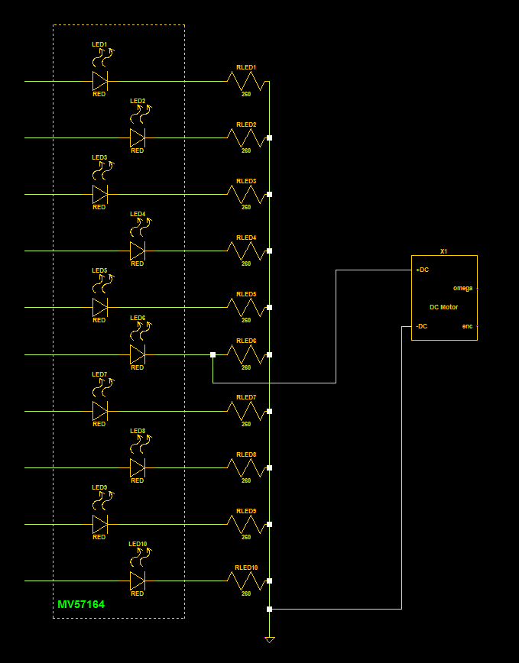
Feedback magnitude calculation
Optimal grasping flex was eyeballed and the ERM was installed in parallel with the corresponding LED on the MV57164.
Notes:
8

Slide 9
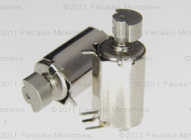
Haptic feedback delivery
Haptic feedback delivery
“The Eccentric Rotating Mass vibration motor, or ERM, also known as a pager motor is a DC motor with an offset (non-symmetric) mass attached to the shaft. ”
We found ours on a shelf in the lab and after a great deal of trial and error attached them to the glove using electrical tape.
Notes:
9

Slide 10
What worked…
What didn’t work…
Flex Sensor data measurement and display for thumb and forefinger.
ERM haptic feedback.
Logical isolation and signal recombination for ERM driver.
Reason: it was unnecessary. Installing the ERM after the MV57164 provided sufficient haptic feedback for our purposes.
555 PWM circuit
Reason: since we didn’t get the LRAs and the ERMs were simple DC motors we had no need for sculpted pulse trains.
Notes:
10

Slide 11
Challenges
Fitting the reference voltages to the gain range
ERMs had very little torque, often thought they weren't working when they were simply caught on the glove
Never ignore your supply chain.
British parts= HUGE shipping costs = no LRAs ☹
Prototype PCBs
PCB layout is a discipline unto itself and should not be undertaken without adequate training and software.
3 LF356s died during the making of this circuit. Their sacrifice was not in vain.
Op amp death throes can be strange and difficult to isolate in a complicated circuit.
Notes:
11

Slide 12
Surprises…
The mysterious overdriven LEDs.
Starving op amps clip the peaks of your waves then raise the floor.
Potential data density exploit.
Op amps and Schmitt triggers are VERY useful. (Who knew?)
Anything else? DC Offset?
Notes:
12

Slide 13
What we wish we’d had time for…
I wish we had time to order the LRAs. The ERMs are useful but not very articulate.
I wish we had time to build out the other fingers.
I wish we had time to build a circuit to account for both x and y coordinates as well as do the math to determine z from x and y.
I wish we had time to build a circuit for the accelerometer.
I wish we had time to build the Hall effect calibration matrix.
I wish we had more time for this presentation…
Notes:
13

